Slide 1
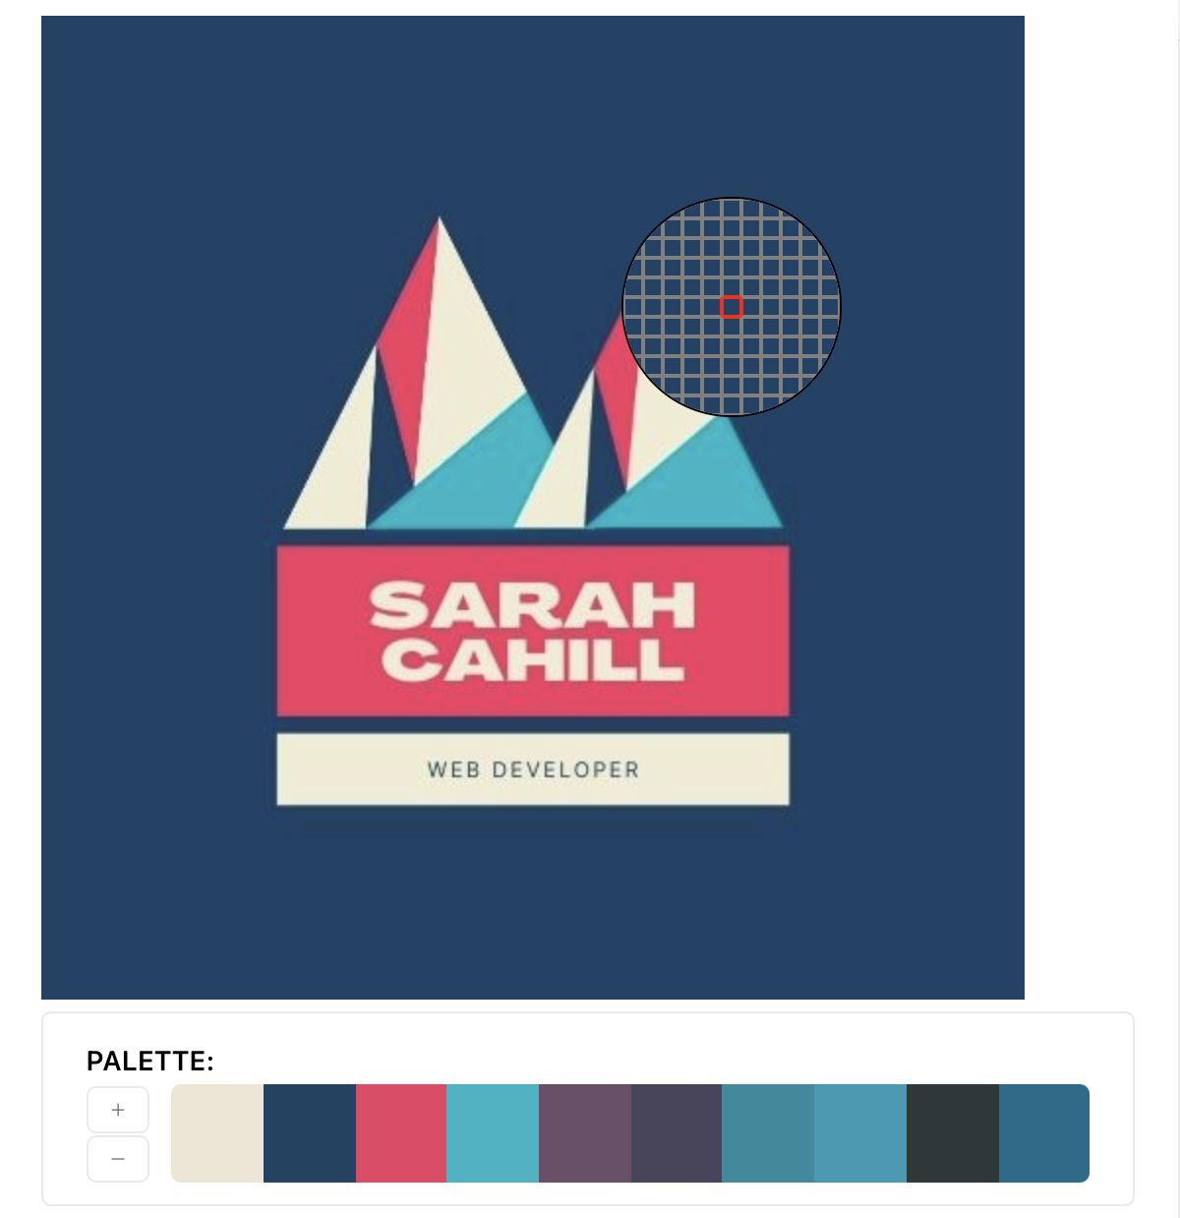
Sarah Cahill
Portfolio

Slide 2

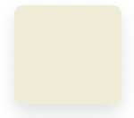
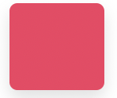
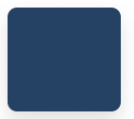
Logo and colour scheme
Logo created in Canva, provided colour pallet.
HEX #00b7c5
HEX #f43c62
HEX #f0ecd3
HEX #f43c62
Image in jpg, png, gif and mp4 format to allow flexibility for utilising images.

Slide 3
Decide on pages
Home page, which links to:
About
Blog
Resume
Contact
Each page has a drop down menu to link back to other pages (does not include own page link).
Each page includes the same footer at end of page.
Insert chart of layout

Slide 4
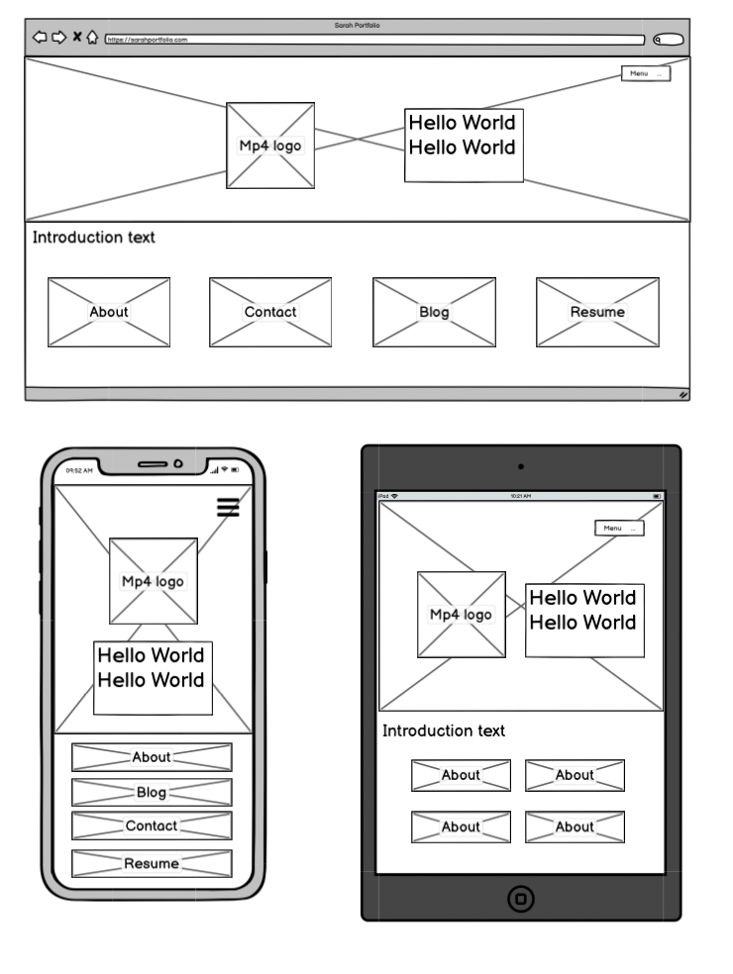
Home page
Clean design
Uses drop down menu
Provides additional links to four other pages (as well as menu bar).

Slide 5
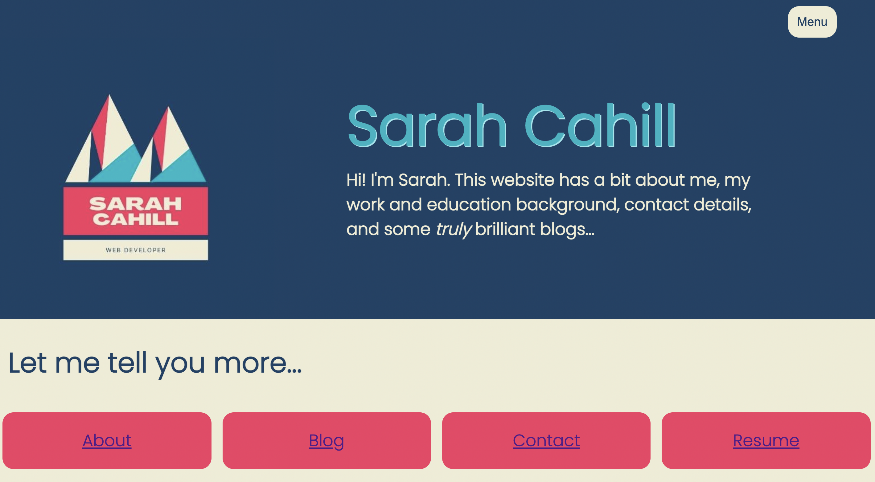

Home page
Insert mobile screenshot
Started off with horizontal page menu, but switched to drop down to avoid repetition on page. Menu has pointer hover and highlight hover on pages (in a 50% opacity). Menu links open to same tab.
Links at bottom have highlighted hovers. These links open to new tabs.
Did consider logo as a mp4, but decided too distracting so went with jpg.

Slide 6
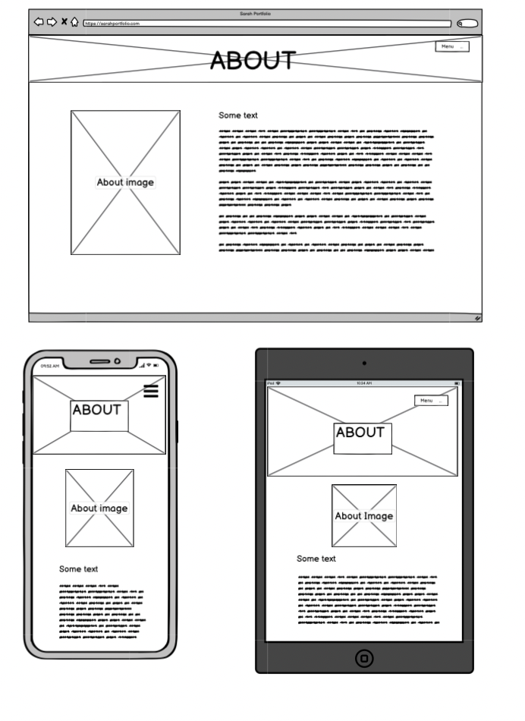
About page
Very simple page
Includes picture and a brief blurb
**something about picture sizing on each layout?**

Slide 7
About page
Insert mobile screenshot
Insert laptop screenshot

Slide 8
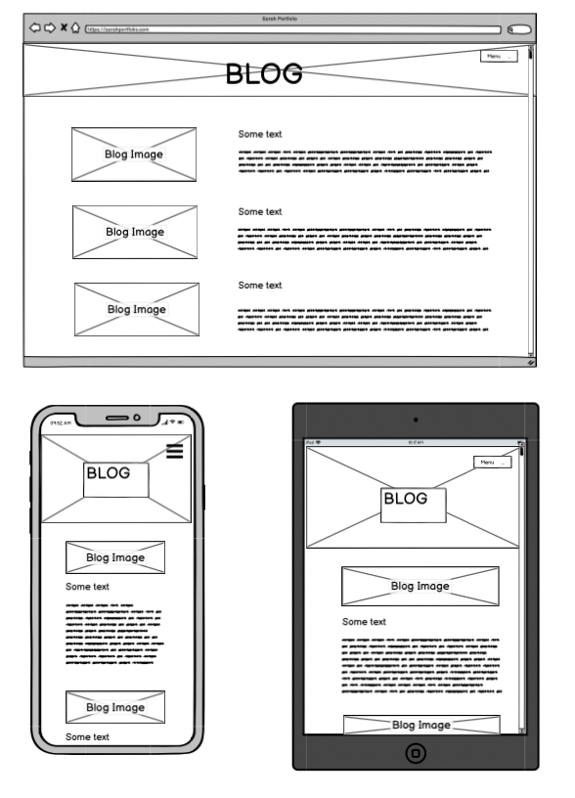
Blog page
Decided to include all blogs on one page for ease of readability (and save site map from having too many single use pages).
If longer, would have used expand text, to increase interest (by giving user a preview of text).

Slide 9
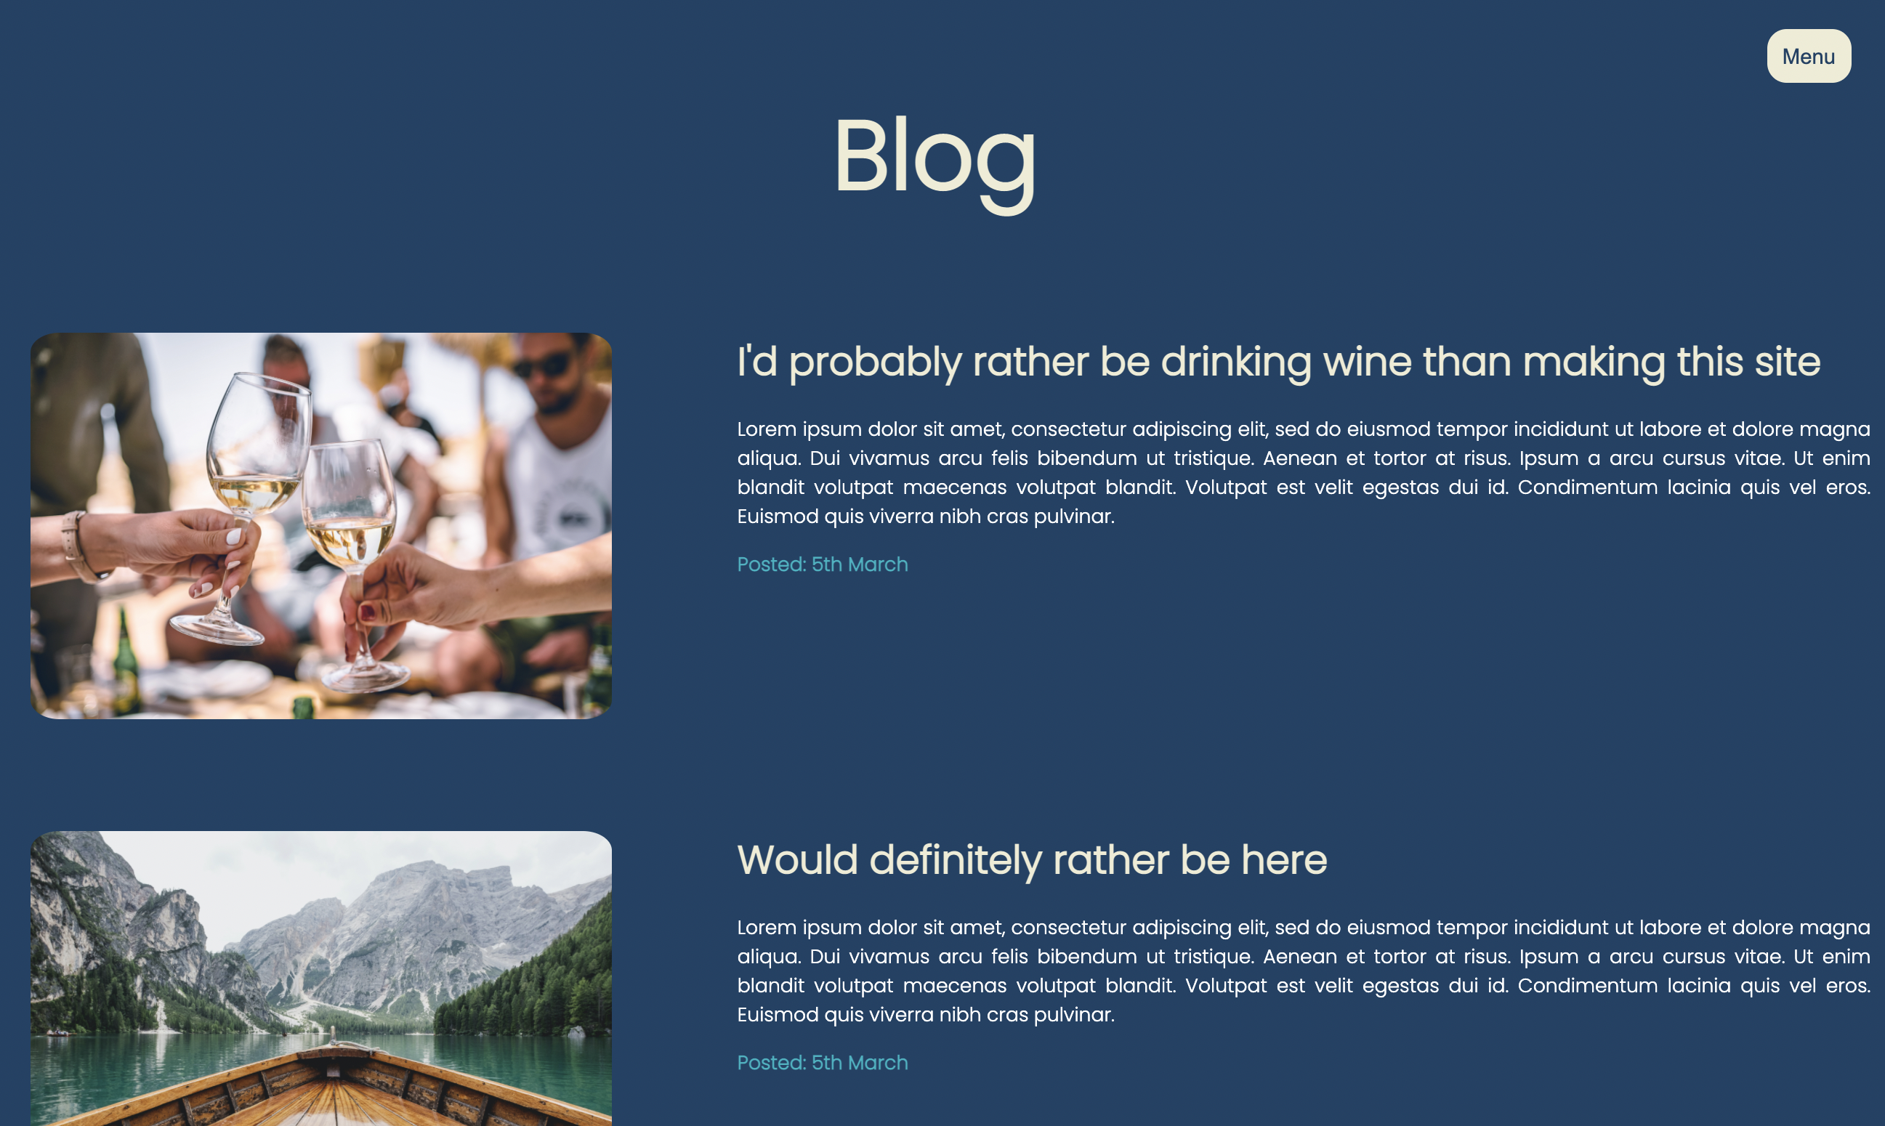
Blog page
Insert mobile screenshot
Used dark blue as background colour (as opposed to beige colour on other pages), as this more dynamic than informative.
’Date posted’ in different colour.
**something about image sizing”

Slide 10
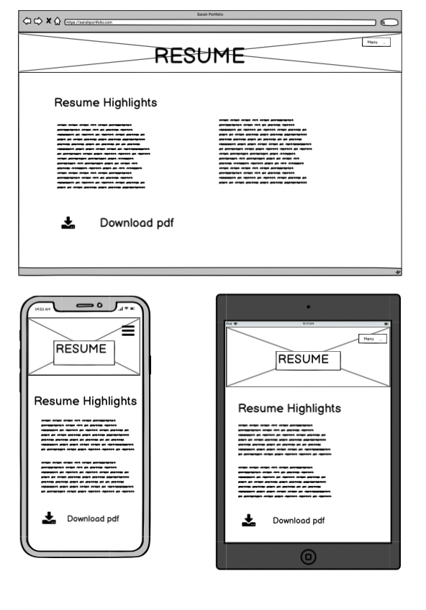
Resume page
Lists education and job highlights in an <ul>.
Link to download at end.

Slide 11
Resume page
Insert mobile screenshot
Insert laptop screenshot
Job titles and degrees/courses as bold, but possibly could stand out more.
Both resume icon and ‘Download Resume’ will download the pdf.

Slide 12
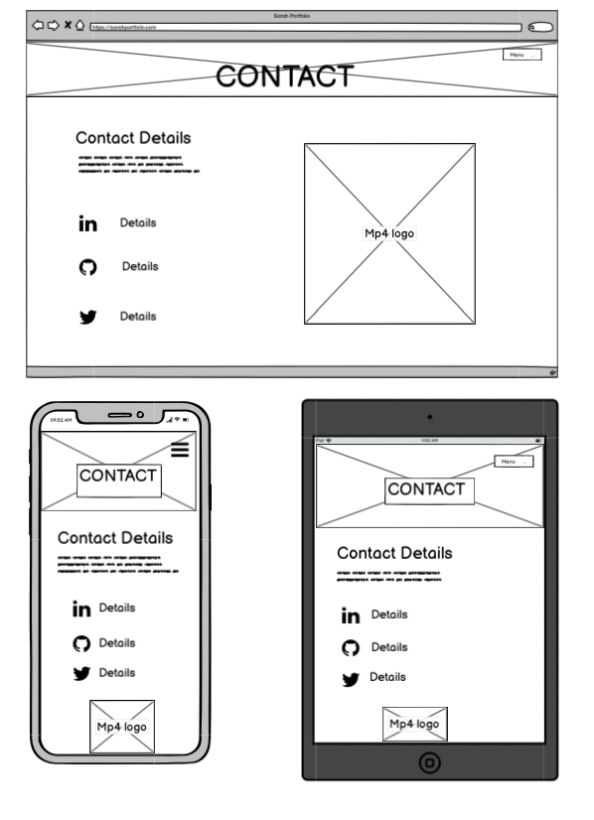
Contact page
Provides email details.
Uses icons to direct users how to follow.
Includes mp4 version of logo.

Slide 13
Contact page
Insert mobile screenshot
Insert laptop screenshot
Clicking ‘Email Me’ provides a pop up link to a pre filled email.
Did have full page list next to logos, but changed to word hyperlinks to keep the page cleaner.
Have coded mp4 logo to run on a loop.

Slide 14
Learnings
Obvious, but doing HTML then CSS made a big difference.
Responsive design is not my friend. Did a lot of coding with Chrome opened as a half width window. Design would look good there and then weird once resized.
** something about mobile first design**
Make sure ‘go live’ in VS Code is working before making heaps of changes and wondering why they weren’t showing up.

